Slide 1
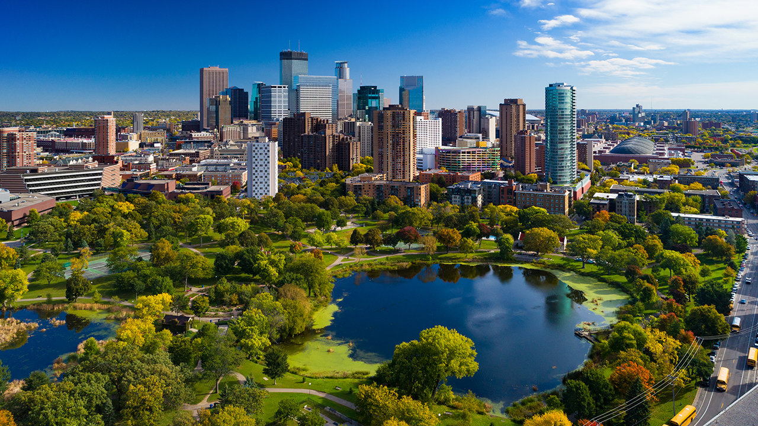
Which Minneapolis Community is Closest to the Most Green Spaces?
Caleb Mueller
December 2nd, 2019

Slide 2
Introduction
Green spaces are areas of untouched or maintained wilderness as well as parks inside of cities (urban parks). There is empirical evidence that green spaces promote increased mental health and general well being. They also make exercise and activities more available to lower income individuals. People who move to greener spaces have been shown to have sustained improvements in mood. It is therefore important for large cities to have many different green spaces spread throughout the city to keep their citizens healthy.
In this presentation we will be looking at a city in the United Sates called Minneapolis. Minneapolis, MN is a city with some of the highest numbers of green spaces in the United States. If someone were to move to Minneapolis and wanted the highest number of green spaces within a walking distance, which one of the 11 communities should they move into?

Slide 3
Data
Data Sources
The data used in this project will be from Foursquare and Wikipedia. The list of the 11 communities in Minneapolis was found on Wikipedia and a CSV document of each community and the coordinates of their geographical center (found on google maps) was created. Foursquare was used for green space location data. Categories in Foursquare that are considered green space are parks, lakes, fields and forests.
Data Cleaning and Wrangling
The CSV file did not have to cleaned or wrangled since it was created by me to match my data needs. It was imported into Watson Studio to be used as a pandas data frame. The parks, lakes, fields and forests location data were requested from Foursquare and made into 4 pandas data frames. It was cleaned to only include columns with the venue name and any location data. Duplicates locations were also removed. Then it was made into 4 clean dataframes.

Slide 4
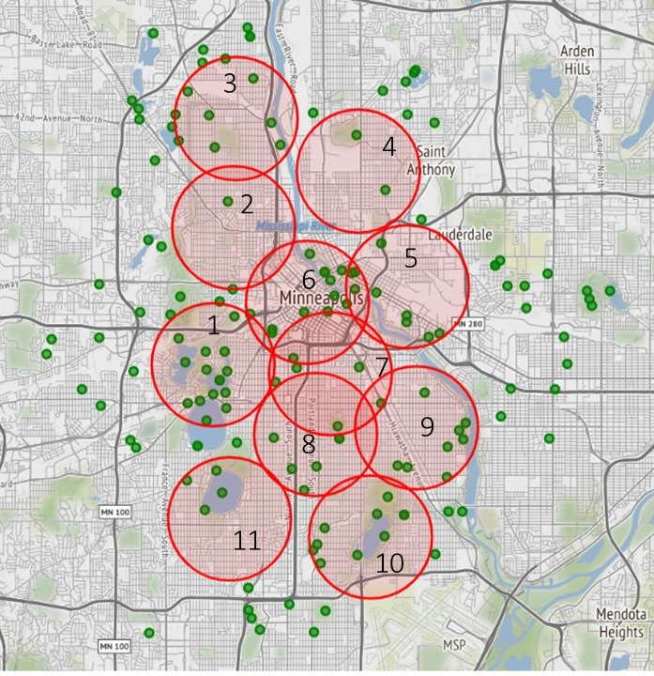
Exploratory Data Analysis
I mapped the gathered data from Foursquare of parks, lakes, fields, forests in Folium as green markers and added the 11 communities as circles with radius equaling 75 at a zoom of 12. I needed to increase the radius of the circles for the outer communities since they are larger. The smaller communities in the center of Minneapolis are close enough together that the circles overlap.
Number | Community | Number of nearby green spaces
1 | Calhoun-Isles | 12
2 | Near-North | 2
3 | Camden | 10
4 | Northeast | 2
5 | University | 9
6 | Central | 17
7 | Philips | 8
8 | Powderhorn | 7
9 | Longfellow | 9
10 | Nokomis | 10
11 | Southwest | 4

Slide 5
Results
From visual and numerical analysis of the Folium map, the community with the most green spaces nearby is Central. The second most green spaces are in Calhoun-Isles. The green spaces in Central are all very small, and the Calhoun-Isles green spaces are much larger. The communities of Near-North, Northeast and Southwest would be the worst choice for a community to live in respect to green spaces. The best choices would be Central, Calhoun-Isles, Camden and Nokomis.
Discussion
After researching the answer to this problem, I realized I could have included the size of the green space as a variable. I could have used this variable to create different sized green circles based on the size of the green space. There may have also been a useful machine learning algorithm I could’ve used, such as K-means clustering. The communities in my map are like centroids and the green spaces as data points.

Slide 6
Conclusion
In conclusion, I’ve found that the best community to live in in Minneapolis if you were looking for nearby green spaces in walking distance would be Central (or commonly referred to as Downtown) community. Central does have the most individual green spaces at 17, but they are all small. If the person looking for a community to live in would prefer larger greenspaces away from downtown, the best community would be Calhoun-Isles with 12 different green spaces.

